Slide 1
Spanish-Speaking Countries
Señora Roldan

Slide 2
Spanish-Speaking Countries
21 countries (including Puerto Rico)
Puerto Rico is a U.S. territory with it’s own governor.
Bolivia has 2 capitals (La Paz, Sucre).
There are more than 450 million native speakers of Spanish, making it second only to Chinese in terms of the most spoken languages in the world. English is just behind Spanish, with approximately 360 million native speakers.
With 121 million native speakers, Mexico has the largest population of Spanish speakers in the world. Spanish is the official language of Mexico, in addition to many countries in Central and South America. Two of the largest Spanish speaking countries in South America are Colombia (about 46 million Spanish speakers) and Argentina (about 41 million Spanish speakers). Roughly 60 percent of the Latin American population speaks Spanish. Most of the rest of the residents speak Portuguese (around 34 percent), and a small percentage speak other languages, such as French, English and various Mayan languages.
You need to know in which part of the world: North America, Central America, South America, Europe, Caribbean Islands, Africa these countries are located in.
https://www.babbel.com/en/magazine/how-many-people-speak-spanish-and-where-is-it-spoken#:~:text=There%20are%20many%20Spanish%20speaking,%2C%20Nicaragua%2C%20Panama%2C%20Paraguay%2C

Slide 3
2 Capitals of Bolivia:
Independence from Spain in 1825. (since 1524)
Sucre- silver mines
La Paz- tin mines
Both capitals help run the country today:
La Paz- President & congressional business
Sucre- Constitutional capital – judicial responsibilities

Slide 4
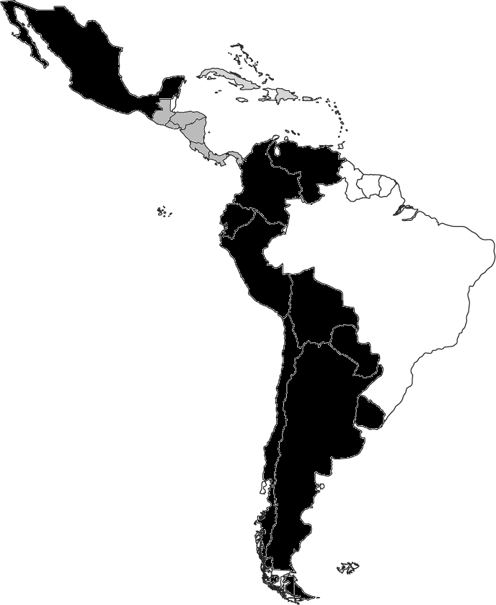
Spanish Speaking Countries- Países hispanohablantes
Caribbean
North America
Central America
South America

Slide 5
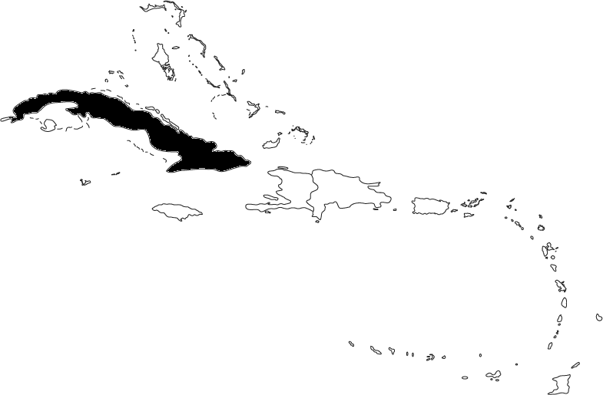
Caribbean Islands- el caribe
País: Cuba
Capital: La Habana

Slide 6
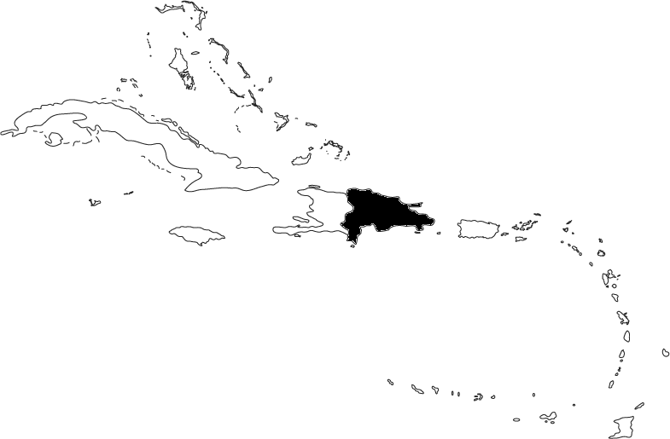
Caribbean Islands- el caribe
País: La República Dominicana
Bahamas-
La Havana, Cuba
Haiti-French/Creole
San Juan, Puerto Rico
Capital: Santo Domingo
Hispaniola

Slide 7
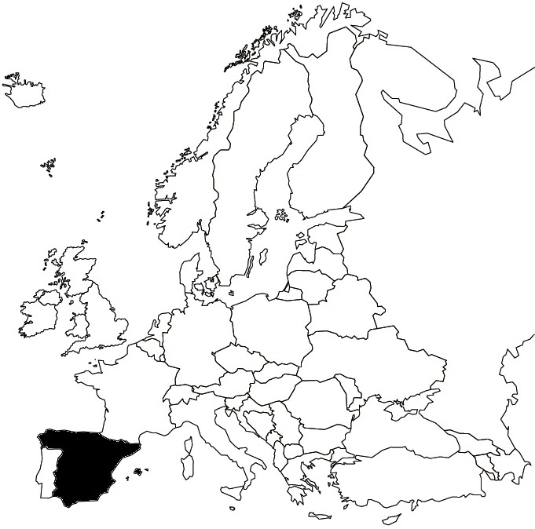
Europe- Europa
País: España
Capital: Madrid

Slide 8
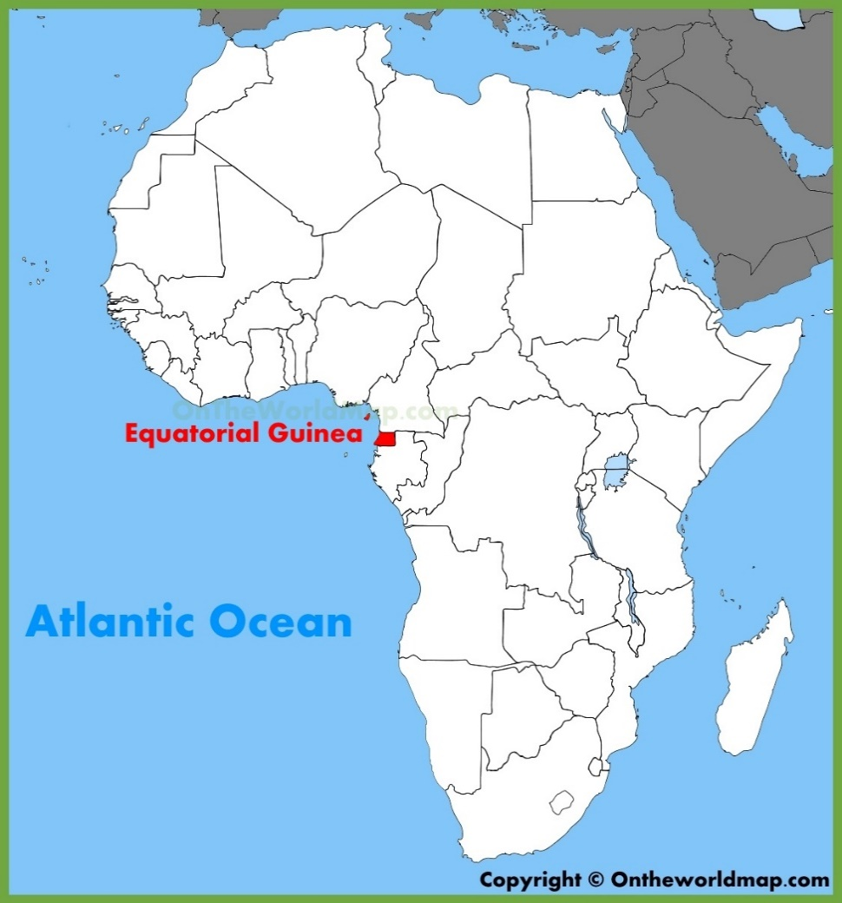
África- Guinea ecuatorial, Malabo
Equatorial Guinea is a Central African country comprising the Rio Muni mainland and 5 volcanic offshore islands. Capital Malabo, on Bioko Island, has Spanish colonial architecture and is a hub for the country’s prosperous oil industry.

Slide 9
To help you remember the order
My México
Grandpa Guatemala
Eats El Salvador
Honey Honduras
Nut Nicaragua
Cheerios Costa Rica
Periodically Panamá

Slide 10
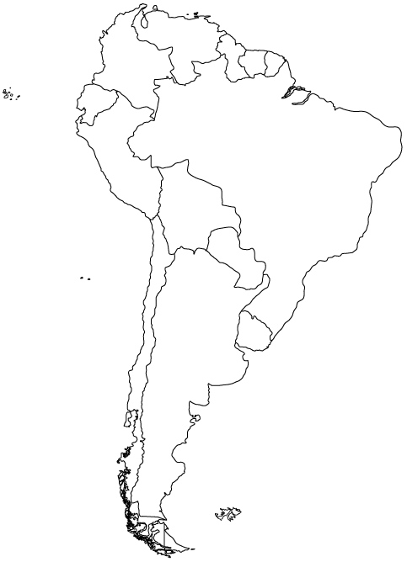
To help you remember the order
Very Venezuela
Crazy Colombia
Eaters Ecuador
Put Peru
Chilies Chile
(and) Apples Argentina
Under Uruguay
Peppery Paraguay
Burritos Bolivia
1
2
3
4
9
8
5
6
7

Slide 11
To help you remember the order:
Can’t/Can
Do
Push-ups
Cuba
República Dominicana
Puerto Rico

Slide 12
I would learn in this order: https://quizlet.com/545302996/where-are-the-spanish-speaking-countries-located-flash-cards/
What country is in Europe?: Spain (España)
What country is in Africa?: Equatorial Guinea
What country is in North America?: Mexico
What countries are in the Caribbean?: Cuba, Dominican Republic, Puerto Rico
What countries are in Central America: Guatemala, El Salvador, Honduras, Nicaragua, Costa Rica, Panama
(My grandfather eats honey nut cheerios periodically)
6. The rest are in South America!
Here are songs for all the countries and their capitals:
South America: https://www.youtube.com/watch?v=Nw1H8aIhKNk
Central America/Caribbean: https://www.youtube.com/watch?v=fAupLjNTae0&t=21s

